Slide 1

Neural Networks in Practice: Overfitting
Presented by:
Elizer Ponio Jr.
Department of Computer Science
College of Computing and Information Technologies

Slide 2
Outline
Introduction
Bias and Variance
Overfitting

Slide 3
Introduction
A model is said to be a good machine learning model if it generalizes any new input data from the problem domain in a proper way. This helps us to make predictions about future data, that the data model has never seen.
Suppose we want to check how well our machine learning model learns and generalizes to the new data. For that, we have overfitting and underfitting, which are majorly responsible for the poor performances of the machine learning algorithms.

Slide 4
Bias and Variance
Bias is the difference between the average prediction of our model and the correct value which we are trying to predict.
When a model has poor performance both on the training and testing data means high bias because of the simple model, indicating underfitting.
Model with high bias pays very little attention to the training data and oversimplifies the model

Slide 5
Bias and Variance
Variance is the amount by which the performance of a predictive model changes when it is trained on different subsets of the training data.
It is a measure of how much it can adjust on a new subset of the training dataset.
High variance occurs when a model learns the training data’s noise rather than the underlying pattern.
As a result, the model performs well on the training data but poorly on the testing data, indicating overfitting.

Slide 6
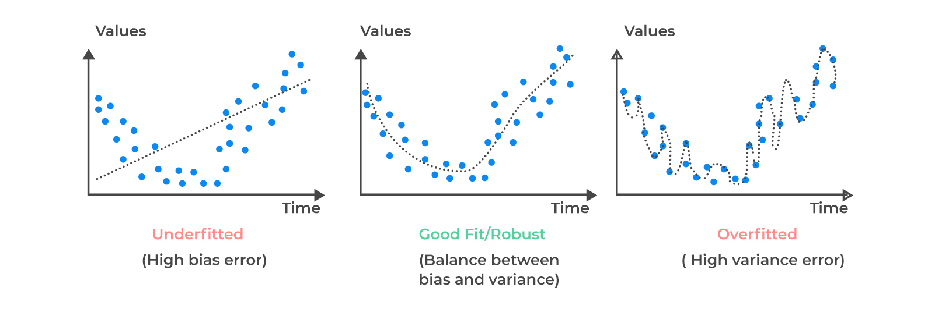
What is Overfitting?
Overfitting is an undesirable machine learning behavior that occurs when the machine learning model gives accurate predictions for training data but not for new data.

Slide 7
Why does overfitting occur?
The training data size is too small and does not contain enough data samples to accurately represent all possible input data values.
The training data contains large amounts of irrelevant information, called noisy data.
The model trains for too long on a single sample set of data.
The model complexity is high (e.g. too many neurons, too many hidden layers), so it learns the noise within the training data.

Slide 8
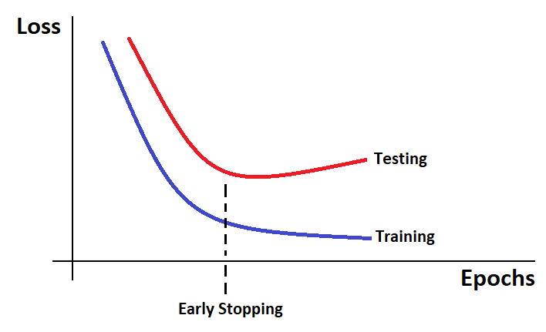
How to reduce overfitting?
Regularization by dropout
Regularization by early stopping

Slide 9









Dropout
$$h_{1}$$
$$I_{1}$$
$$O_{1}$$
$$h_{2}$$
$$I_{2}$$
$$O_{2}$$
$$h_{3}$$
$$I_{3}$$
$$h_{4}$$

Slide 10









$$h_{1}$$
$$I_{1}$$
In dropout, we randomly shut down some of a layer’s neurons at each training step by zeroing out the neuron values. The fraction of neurons to be zeroed out is known as the dropout rate
$$O_{1}$$
$$h_{2}$$
$$I_{2}$$
$$O_{2}$$
$$h_{3}$$
By using dropout, in every iteration, you will work on a smaller neural network than the previous one and therefore, it approaches regularization.
$$I_{3}$$
$$h_{4}$$

Slide 11
Early Stopping
In Regularization by Early Stopping, we stop training the model when the performance on the validation set is getting worse increasing loss decreasing accuracy, or poorer scores of the scoring metric.

